Slide 1
Diabetic Analysis on USA counties
Presented by
Madhulika Gupta

Slide 2
Questions asked
Major factors that effect occurrence of diabetes in US population
Name of factors
Obesity
Availability of food stores and % of stores that accept SNAP and WIC
Income factors(median household income)
Availability restaurants(fast food and full service) and % of restaurants that accept SNAP
Availability of farmer markets and % that accept the SNAP and WIC

Slide 3
Technologies used
Back end / cleanup
Python
Pandas
Sklearn
Front End / Data Visualisation
matplotlib
Tableau

Slide 4
Data Source
https://www.ers.usda.gov/data-products/food-environment-atlas/data-access-and-documentation-downloads/#Current%20Version
Credibility: data published by usda.gov

Slide 5
Sequence of method adopted for the project
Extracting the data from source
Creating multiple csv’s from workbook
Creating Data frame of each of the csv’s
Selecting and renaming columns
Merging the worksheets
Using sklearn to make a linear regression model
Use train, test split
Use standard scaler
Fit and score the model

Slide 6
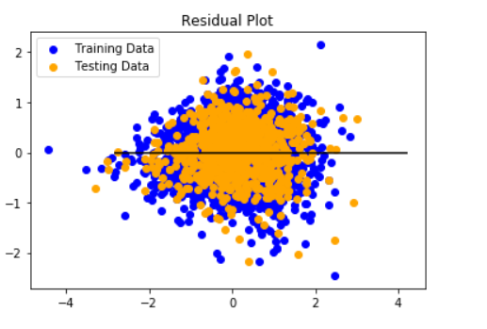
Sk-learn values
Training Score: 0.7023462457014373
Testing Score: 0.7131523555249148
Mean Squared Error (MSE): 0.28
(mean squared error tells you how close a regression line is to a set of points). A small MSE is better since it implies agreement between the prediction and the reality. MSE is the mean squared difference between your estimate and the data. Smaller MSE generally indicates a better estimate, at the data points in question.
R-squared (R2 ): 0.71
(R-Squared is a statistical measure of how close are the data fitted to the regression line.

Slide 7
Pulling weights of X-factors in Tableau
Mean Squared Error (MSE): 0.28343240317564106 R-squared (R2 ): 0.7131523555249148
https://public.tableau.com/profile/madhulika.gupta#!/vizhome/diabetesPredictionAnalysis/ObesityVersusDiabetesperCounty?publish=yes

Slide 8
Take Aways from the Analysis
Percentage of population change from 2012 – 2016 has been negligible in most counties , even being negative in some of the.
Rate of diabetes has risen multiple fold as compared to the population change
Obesity is a major factor in increase in diabetic rates
Counts of Stores(including those that accept SNAP ) has remained stable all through the years
The % increase or decrease of fast food restaurants has no direct effect on the diabetes rates.

Slide 9
Take Aways from the Analysis
No of markets has remained almost stable( including supercenters, grocery stores , specialized food stores and SNAP authorized markets) and minimal effect on the rate of diabetes.
No of fast food restaurants have increased in most counties( and could be a contributing factor for increase.
Diabetic Rate is low where ever median income is high

Slide 10
Lessons learnt
Obesity and factors leading to Obesity need to be controlled in order to change the rate of diabetes.
More markets and restaurants authorized to accept SNAP and WIC are required to give access to better quality food.

Slide 11
Thank you

